Slide 1

Helping Videogame Developers Thrive in an Accelerating Market
AI Academy Capstone Project – Group 5

Slide 2

Elevator Pitch
Approach, Scope, & objectives
Objective: Provide leading and in-time insights to videogame developers to help them thrive in an accelerating market.
Key Drivers:
Industry:
Significant Growth and popularity driven by increasing accessibility, new market entries, and large volume of consumers.
Business Model:
Use and leverage statistically built AI models to provide developers with real-time feedback and sentiment analysis on their games from one of the most popular social media platforms around.
High Level Details:
Model Includes: Baseline Models Neural Network Data Cleaning Techniques: Tokenization Term Frequency – Inverse Document Frequency (TF-IDF) Data Used: Kaggle Twitter Video Game Set
Notes:
Landon

Slide 3
Agenda
Questions?
We will save time for Q&A at the end of the presentation.
1.
Meet the Team
2.
Business Overview
3.
Data Understanding / Model Building
4.
Why work with us?
5.
Q&A
Notes:
Landon

Slide 4





Meet the team
Deloitte AI Academy – Capstone Group 5
Jahnavi
Brahmbhatt
Miguel Cruz Le Hardy
Brandon Cancino Meyer
Landon Steele
Patricio Solorio Cabrera
Risk & Financial Advisory Analyst
Cyber & Strategic Risk
Costa Mesa, CA
DC Junior Associate
New Business Innovation (NBI)
New Orleans, LA
ARDC Analyst
AI & Data Engineering
Strategy & Analytics
MX - Querétaro
Risk & Financial Advisory Analyst
Accounting & Internal Controls
Dallas, TX
ARDC Analyst Intern
Strategy & Analytics
MX - Querétaro
Notes:
Landon

Slide 5


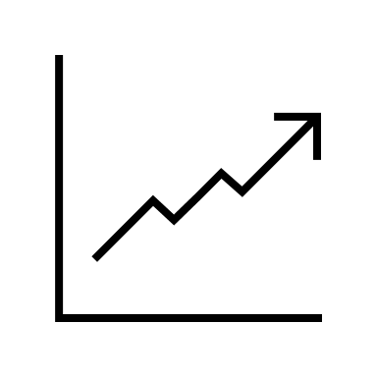

Business Understanding
Evaluating the opportunity at hand for the videogame industry.
MARKET TREND
The increased popularity of gaming and esports due to the COVID-19 pandemic have established online-gaming as an ever-growing interaction medium for people worldwide; updates need to be rolled out periodically in order to engage and maintain player bases.
BUSINESS OPPORTUNITY
Videogame companies face the challenges of continuously improving their games to meet expectations of millions of players. The goal is to obtain actionable insights from player sentiment in the online fanbases related to newly deployed content as it is released.
STRATEGICAL APPROACH
Leveraging AI models, we plan to analyze online discourse by aggregating, processing, and analyzing posts to gauge the general opinion of a game in order to create actionable and profitable insights regarding the future of these projects. This will allow us to react in real time to the demands of a playerbase.
Notes:
Brandon
Leveraging statistically built algorithms and AI we strategically built models to analyze sentiments on twitter, one of the most popular social media platforms for gamers. By aggregating, processing, and analyzing tweets from gamers related to multiplayer games we aim to provide an accurate and real time analysis to developers that will provide exclusive insights, experiences, and opinions of players. This will allow them to obtain knowledge of and react in real time to everchanging demands of their consumers
With exponential growth of the gaming industry, videogame manufacturers face the challenges of continuously adapting and improving their games to meet the ever-changing expectations of millions of users. It is currently unfeasible, costly, and timely to obtain actionable insights as player sentiment is limited to surveys, online forums, and delayed feedback.

Slide 6


Data Understanding & Models
Data sources understanding & types of models proposed
Model Background
2 Data Sets
Data Cleaning
Data from Twitter | Used for Financial Analysis
Source: Kaggle | Already tagged as: Positive Neutral Negative
Overview: The dataset already tagged with sentiment about videogames | Limited number of box office observations, primary purpose of data is not financial
Methods:
Basic Data Preprocessing Remove Emojis Remove Entities Tokenization Frequency Distributions Stemming Lemmatization Compute TF-IDK Vectorization
The idea would be to use Twitter API or other similar social media sites (Reddit, Threads, YouTube comments, etc.) to collect data but with an already tagged dataset from Kaggle.
Notes:
Patricio:
Our team used 2 data-files that come from Kaggle a training dataset & validation dataset this datasets were aimed towards on sentiment about video games, in other words if a game has a positive, negative or neutral comment, with this data already labeled, this will help us predict
Our data went through natural language processing steps given the fact that we'll be working with text in order to provide this processed data for our models that we will be using.
From the process the most important to prepare the data is removing emojis and entities (this are the name of the games or products),
So we began with the NLP process that is tokenization, removal of stop words, running stemming and lemmatization in our data to compute Term Frequency & Inverse Document Frequency for vectorization of the text and begin with our choice of machine learning models:
Multiclass Logistical Regression
Neural Networks
Decision Trees
Q&A: We remove entities because we had already a column from our original data-frame.

Slide 7



Our Models:
What we built…
Multi-Class Logistic Regression
Decision Tree Classifier
Neural Network
To get access to information...
Better
Faster
Cheaper
Unique insights
Weeks, not months
Flexible resourcing
Notes:
Tags: text, crowdsourcing

Slide 8
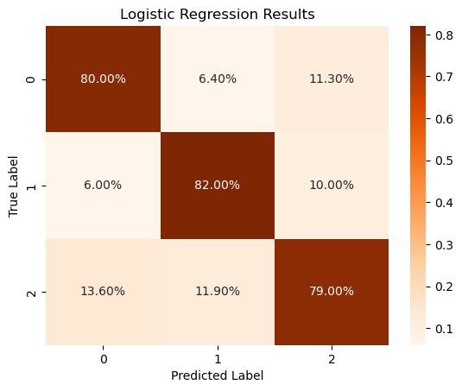
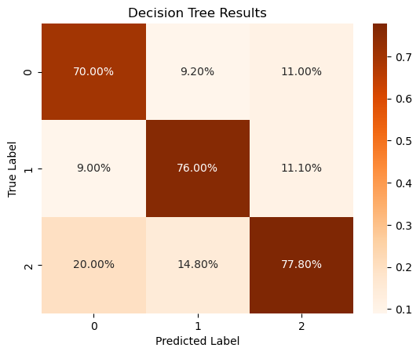
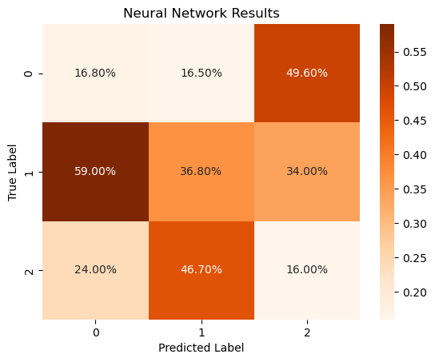
Main Models
Our Models
The models we built to help you thrive
 | Precision by model
Label | Logistic | Tree | Neural Net
Positive | 80 % | 71 % | 16.8%
Negative | 82 % | 77 % | 36.8%
Neutral | 79 % | 78 % | 16%
Key:
0 – Positive
1 – Negative
2 – Neutral
Overall Model Accuracy:
Logistic Regression: 80%
Decision Tree: 75%
Neural Network: 88%
Notes:
Tags: text, landscape, data visualization, trends

Slide 9
Main Models
What does this mean for your organization?
Our Model Will:
Enable data-driven decisions improving overall performance and effectiveness
Better
Accelerate feedback loops by utilizing in time opinions of customers enabling you to iterate and implement improvements at a rapid pace
Faster
Reduce the need for costly market research, tiring focus groups, and be able to focus your development process into what really matters to users
Cheaper
Notes:
Tags: text, landscape, data visualization, trends

Slide 10

Recommendations
IMPLEMENT THE MODEL INTO EVERDAY DECISIONS
To maximize profitability the company should act now!
JUMP AHEAD IN A THRIVING MARKET
Our analysis and model will allow for real in-time feedback to be used in the day to day.
The current market conditions align for the opportunity to continue to thrive – why not assert yourself as a market leader?
FOCUS ON REAL-TIME DATA AROUND THE WORLD
INVEST IN API
Invest in API for Reddit, Twitter, Threads and other social media platforms to have access to a variety of users & opinions
Serve users all over the world with different expectations and be able to cater to them all
Notes:
Tags: DNA, underline, text

Slide 11


Next Steps
Where do we go from here?
1
2
3
Generate our own Data Set
Implement ML pipeline
Utilize Pipeline to provide in-time feedback to developers
Let’s work together!
Climb the Market
Obtain data from across platforms that we can analyze in real time
Improved automation, scalability, efficiency, monitoring, and flexibility
Immediate feedback from consumers after updates for example
Notes:
Tags: text, crowdsourcing, list, numbers

Slide 12
Q & A
Thank you!
Notes:
Tags: statement, quote, callout

Slide 13
Final Model / Analysis
Does director experience lead to a higher average percentage of Fresh ratings on Rotten Tomatoes?
Notes:
Aidan

Slide 14
Multi-Class Logistic Regression
Baseline Models
Decision Tree Model

Slide 15
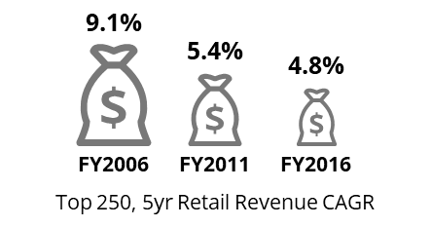
Main Model
Neural Network
Long-Short-Term Memory model
The market is looming in uncertainty…
As the environment changes, there is growing pressure on consumer brands to emulate the qualities of startups such as building flexible supply chains, tightening operating expenses & overhead, and increased investment in growth opportunities.
Economic Trends¹
Slow growth in developed economies
22%
of CPGs have turned to Zero-Based Budgeting (ZBB)²
Low inflation despite tighter labor markets
1.9%
2018 average US inflation
56%
increase in the usage of ZBB in 2017 compared to 2016³
$280M
on average saved by firms per year with the help of ZBB³
Asset price bubbles & risk from monetary tightening
Sharp rise in asset prices including equities, bonds, and property
…leading to rampant investor pressure on organizations to act
1. Deloitte CIP Global Powers of Retailing 2018 Report
2. Deloitte Commercial spend in consumer products: 2016
3. “Global Companies Extend Use of Zero-Based Budgeting to Slash Costs” Wall Street Journal 2018
Notes:
Tags: text, landscape, data visualization, trends

Slide 16
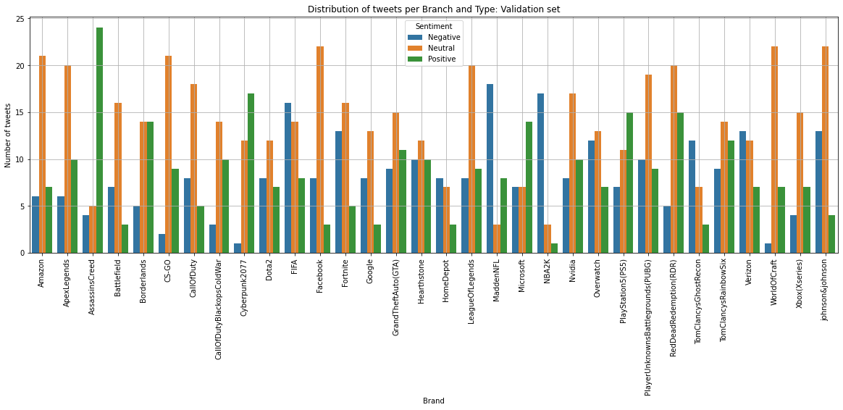
Main Model
Our Model
The model we built to help you thrive
Notes:
Tags: text, landscape, data visualization, trends

Slide 17
Conclusion
The thriving market and ability to react in real time to users demands is a unique opportunity to throw your company to the front of the market
The market is booming, the time to act is NOW!
Why?
Exponential Market Growth
How will Videogame developers react?
Inability to adapt in real- time
Videogame developers cannot react in real-time to changing demands/expectations of users
Using our model – companies can adapt, react and thrive in a growing market and be ahead of competitors by reacting to sentiment in real-time.
Being up to date – is being ahead!
1. Deloitte CIP Global Powers of Retailing 2018 Report
2. Deloitte Commercial spend in consumer products: 2016
3. “Global Companies Extend Use of Zero-Based Budgeting to Slash Costs” Wall Street Journal 2018
Notes:
Tags: text, landscape, data visualization, trends

Slide 18
Rubric
Describing the project goals, data, methods, and results
Explicitly connecting the descriptions of the project to stakeholder needs
Having a distinct introduction and conclusion
Using plain language and clear visuals accessible to non-technical stakeholders

Slide 19
Data Preparation
Overview of data cleaning steps & techniques
Data processing
Steps
Remove of duplicates & null values Remove emojis Remove Entities Tokenization Stopwords Stemming & Lemmatization Calculate Document Frequency Compute Term Frequency – Inverse Document Frequency Vectorization Normalization
Notes:
Patricio:
From the process to prepare the data we started with the basics:
remove duplicates and null values, remove special characters we think they are unnecessary likeemojis, and remove entities or game names that already exist in a column of our original dataframe (for this part we had to create a dictionary of names of entities of each game of the database).
So we can begin with the nlp process that is tokenization, removal of stop words, stemming and lemmatization so we can compute Term Frequency & Inverse Document Frequency for vectorization of the text and begin with our modeling.

